Slide 1
Chatbot Teaching Assistant
Jan 20 2022

Slide 2
Team Members
Name | Year | Major
Jonah Que | May 2022 | Computer & Systems Engineering
Roland Rao | May 2022 | Computer Science / Computer & Systems Engineering
William Thramann | May 2022 | Industrial Systems and Managerial Engineering
Zhuoming Wu | May 2022 | Electrical Engineering
Leyang Zhang | May 2022 | Computer & Systems Engineering
Sandor Magyar* | May 2022 | Computer & Systems Engineering​ / Computer Science
Megan Stahl | May 2022 | Computer & Systems Engineering
Mitesh Kumar | May 2022 | Computer Science / Computer & Systems Engineering
Zachary Johnson | May 2022 | Computer & Systems Engineering
* Lockheed-Martin liaison

Slide 3
Outline
Project Description
Preliminary Findings
User Interface
Back End
Next Steps

Slide 4
Project Description
Students in Multidisciplinary Capstone Design often ask questions about the course that can be answered with information on the course's EDN (Electronic Design Notebook) wiki pages
Help students find this info by designing a chatbot to automatically search for it and respond
For now, only considers content on the wiki, which all students can access
Personalizing to individual students would require secure storage of personal info

Slide 5
Preliminary Findings – User Interface
3 options for deployment:
Integrated into the EDN site
Has to be written in Ruby on Rails as a Redmine plugin
(Redmine is the framework EDN is based on)
Standalone site
Webex bot
Hosted by RPI

Slide 6
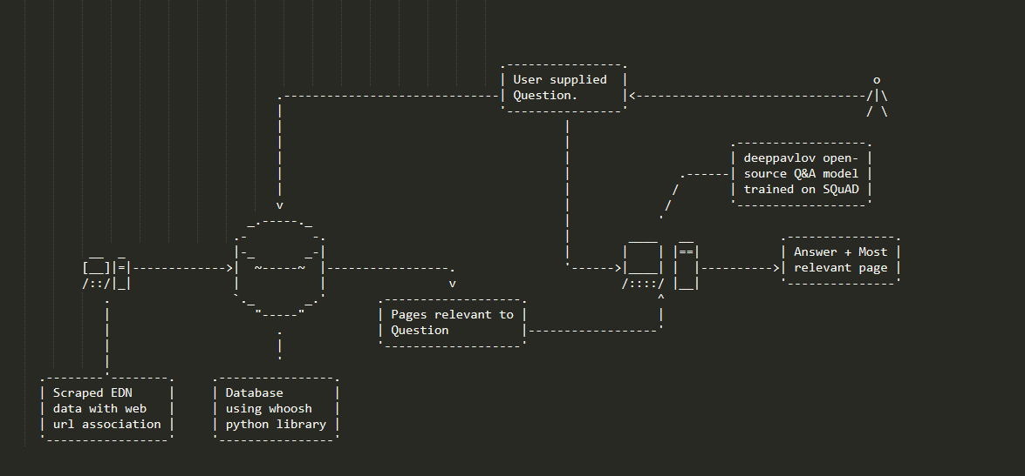
Preliminary Findings – Back End
https://whoosh.readthedocs.io/en/latest/intro.html
https://rajpurkar.github.io/SQuAD-explorer/
https://deeppavlov.ai/
https://rpi.box.com/s/eiwmexk0laozkuxf4rldao566k51hkki

Slide 7
Next Steps
Identify customer needs
Evaluate and pick framework
Decide best way to implement chatbot
Develop example scenarios for interaction between chatbot and students
Define how to add to bot's knowledge base
Build and implement
Test and evaluate

